Slide 1
TUTORIAL “Application of IEC CIM Standards in Power System Modeling, Smart Grid and Enterprise integration” 2012 IEEE PES General Meeting, San Diego, California July 22-26
Instructors:
Jay Britton, Fellow IEEE
Dr. Alan McMorran, Member IEEE
Margaret Goodrich, Member IEEE
Dr. Enamul Haq, Senior Member IEEE

Slide 2
Tutorial Section XII ***** CIMTool
Margaret Goodrich
SISCO
margaret@sisconet.com

Slide 3
Introduction
The purpose of this presentation is to describe the use of CIMTool
Some of the uses of CIMTool include:
Definition of information exchange profiles
Development of RDF Schemas
Validation of CIM XML instance files
Validation of incremental CIM XML files

Slide 4
Contents
CIM Profiles
CIMTool Installation
Creating a CIMTool Project
Importing a Schema
Creating and Editing a Profile
Importing a Profile (Several Methods)
Generating RDF Schemas
Importing a Model
Validating a Model
Importing and Validating an Incremental Model
Updating a Schema
Miscellaneous

Slide 5
CIM Profiles
CIM PROFILES

Slide 6
What is a Contextual Profile?
The set of classes, attributes and relationships in a contextual profile (a.k.a. profile) is a subset of the classes, attributes and relationships found in a schema
The cardinality of a relationship in a profile is either the same or more restrictive than the relationship in the schema
A profile is often given a name (e.g. CPSM)
Each profile will have an assigned namespace
Profiles are also known as ‘contextual models’
Within CIMTool, profiles are managed using an OWL format, where a .owl extension is used
Important to note that OWL is based upon RDF
Profiles can be realized in a variety of forms, including but not limited to RDFS, XML Schema, HTML and Word Documents

Slide 7
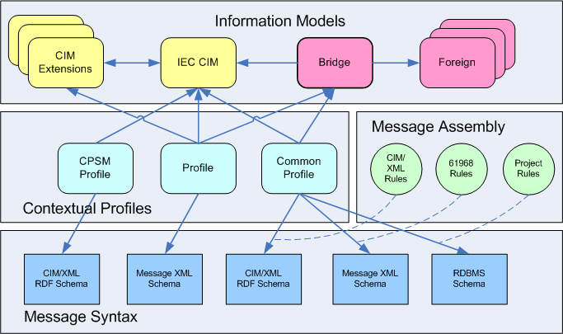
Information Models and Profiles

Slide 8
CIMTool Installation
CIMTool Installation

Slide 9

What is CIMTool?
CIMTool is an Eclipse plugin
It provides the means to:
Define profiles from a UML model
Import profiles from a spreadsheet
Validate profiles
Validate instance files against a profile
Validate incremental files against an instance file and a profile
Generate RDF schemas from a profile
… and more

Slide 10

Preparation for Installation
You should have a PC running a recent version of Windows, Linux or Mac OS, with at least 1GB memory
Recommend at least 2GB free disk space (much more is recommended if you will be working with large CIM network models)
You need an internet connection, noting that there may be 200MB of downloads required for installation
You need a Java runtime environment (JRE)
Java 5 JRE is currently recommended
If you don’t have one you can download from http://java.com

Slide 11
CIMTool Installation
Go to http://cimtool.org
Version 1.9.3 is currently available for download
Download a zip file with Eclipse and CIMTool (full installation package)
Following the directions on the screen

Slide 12
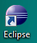

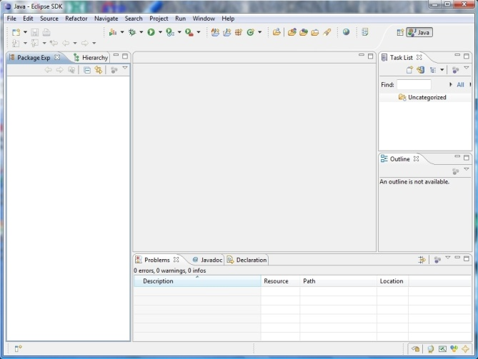
Starting CIMTool
Click on the Eclipse icon
The Eclipse startup dialog will appear
Define a ‘workspace’ directory when prompted
The workbench view will then appear

Slide 13
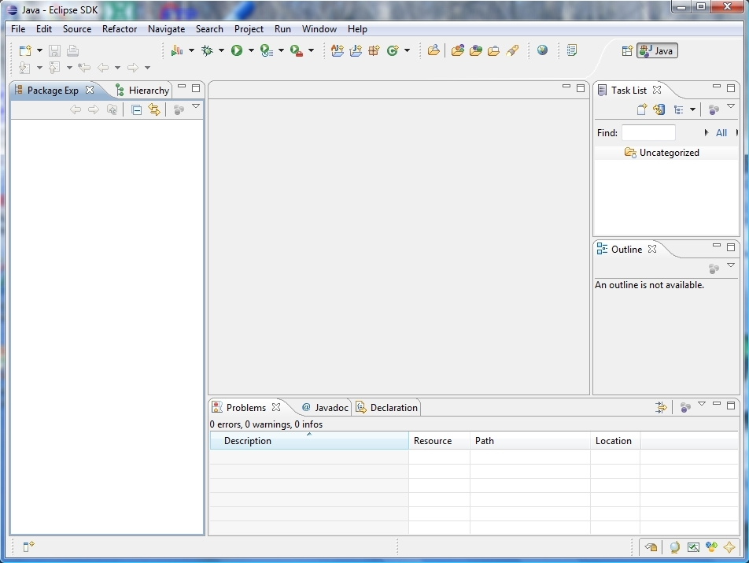
Eclipse/CIMTool Workbench
Initial default view before any projects are created
Default installation supports Java development

Slide 14
CIMTool/Eclipse Hints and Tips
Files, Packages and Workspaces:
It is important that you never add, modify or delete anything inside a workspace directory with tools other than Eclipse
If there is ever a ‘resource out of sync’ problem, you can usually correct by using the ‘refresh’ option
You may however safely read files directly from the workspace folder if needed

Slide 15
Creating a CIMTool Project
Creating a CIMTool Project

Slide 16
CIMTool Projects
Each project has a named folder in the workspace directory
Each CIMTool project will have four sub-folders:
Incremental: for CIM XML incremental files in RDF format with a .xml extension
Instances: for CIM XML instance files in RDF format with a .xml extension
Profiles: for profile definitions, where
Profile definitions are stored in an OWL & RDFS formats
Log files, which may identify errors, are text files with a .log extension
Depending upon the usage of CIMTool, there may also be HTML, RDFS and XSD files
Schema: for the CIM model in XMI format with a .xmi extension (Generated using the UML model from the EA Tool)
Folders and files that have errors may include a red X on their associated icon

Slide 17
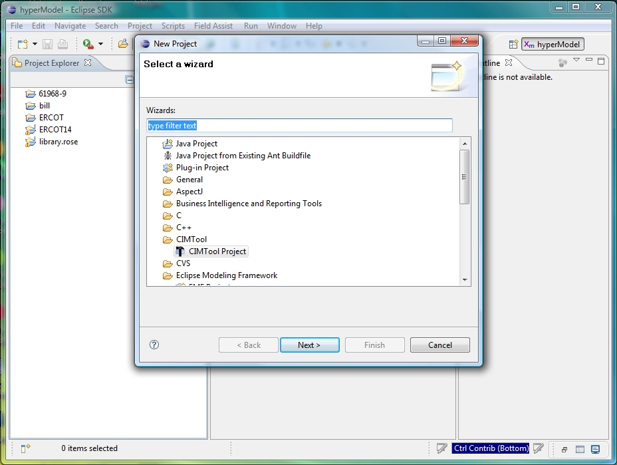
Creating a New CIMTool Project
Select ‘File > New > Project’
Select ‘CIMTool Project’ option
Click ‘Next’

Slide 18
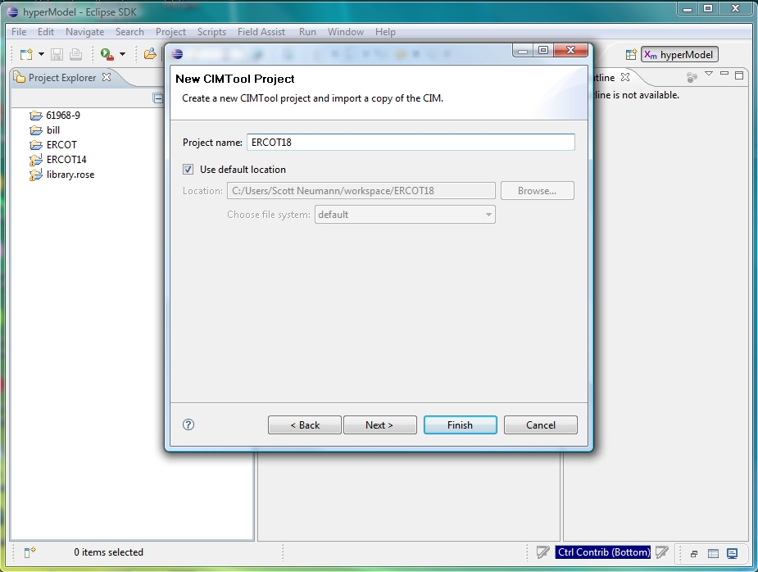
Creating a New CIMTool Project
Name it – e.g. ‘IIE18’
Click ‘Finish’
This will create a new folder in your workspace directory

Slide 19
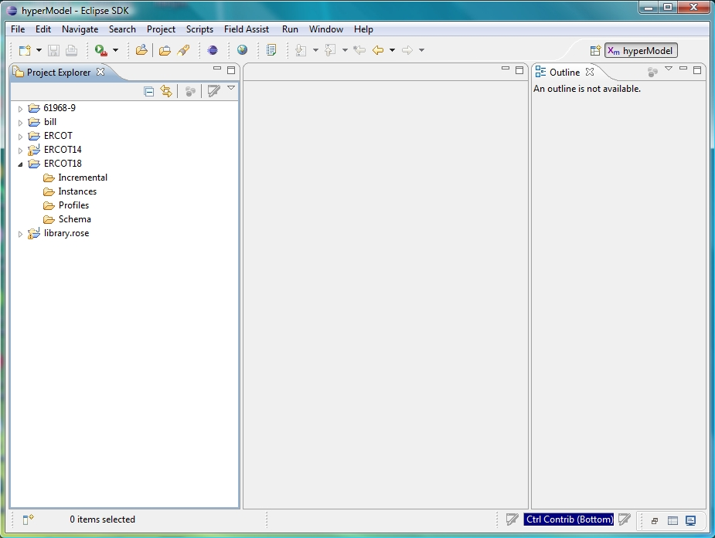
Browsing the Project
Click on arrow to tClick on arrow to the left of the desired project name in the Project Explorer to expand it
See that project has the 4 set of folders
Expand sub-folders to see

Slide 20
Importing a Schema
Importing a Schema

Slide 21
Importing a Schema
Schemas describe the classes, attributes and relationships defined by a UML model
Anything defined by a profile MUST be described within the UML model
Schemas must be in a suitable XMI format for import
The XMI files are typically generated from the CIM UML model created/maintained using Enterprise Architect
Schemas will be stored in the ‘Schema’ folder of the project
There is typically one schema for a project, although there are cases where there may be more than one

Slide 22
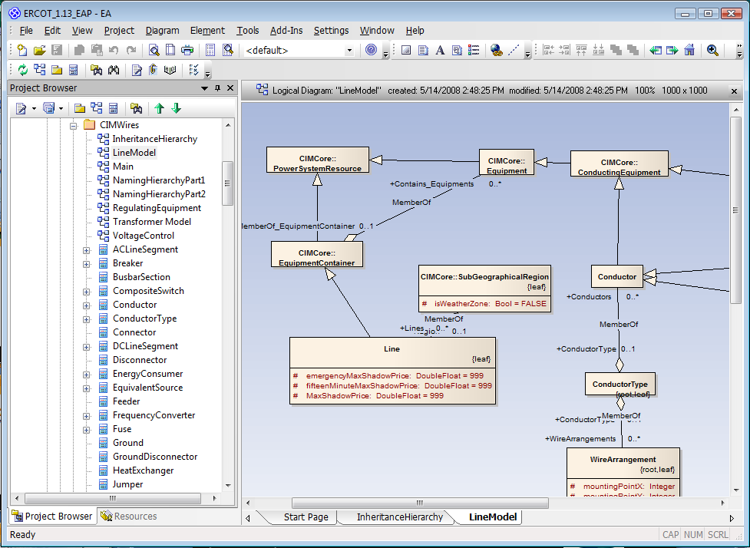
Schema in a UML Tool

Slide 23
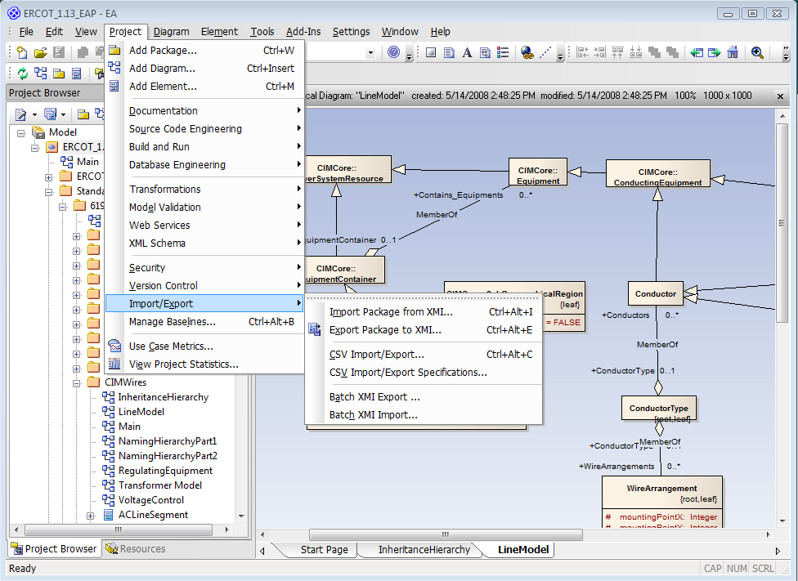
Exporting UML Model as XMI
In Enterprise Architect select the top-level package
Select Project > Import/Export > Export Package to XMI

Slide 24
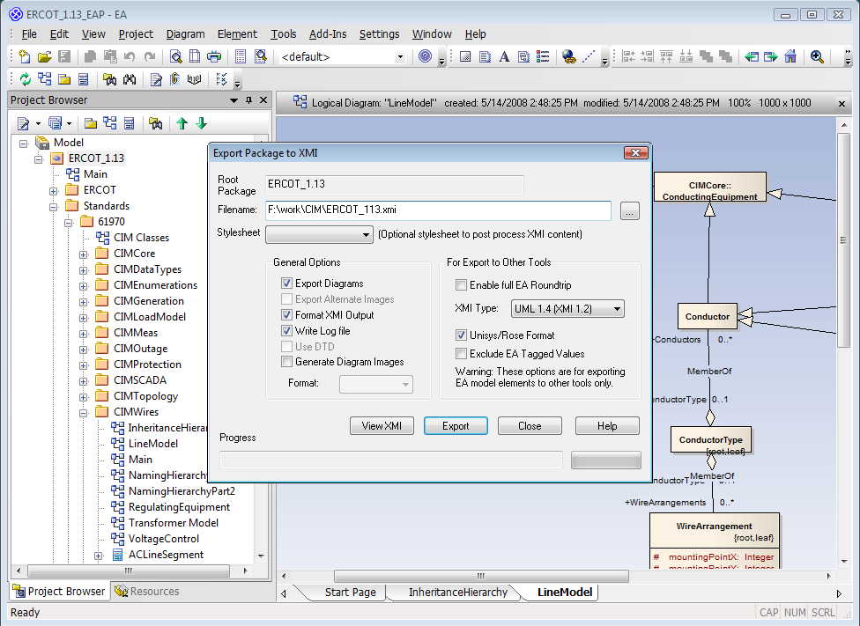
Exporting XMI from UML Tool
Use export options shown
Export as UML 1.4
Unselect ‘Enable full EA Roundtrip’
Select ‘Unisys/Rose format’ option
Enter file name for XMI file
Click on Export button

Slide 25
Schema Import within CIMTool
Schemas are imported when creating a new CIMTool project
Schemas can also be added to supplement an existing schema
Schemas can also replace an existing schema, as in the case of a new CIM version

Slide 26
Initial Schema Import
Select ‘File > Import’
Note the different import options under CIMTool
Select ‘Import Schema’ option
Click ‘Next’

Slide 27
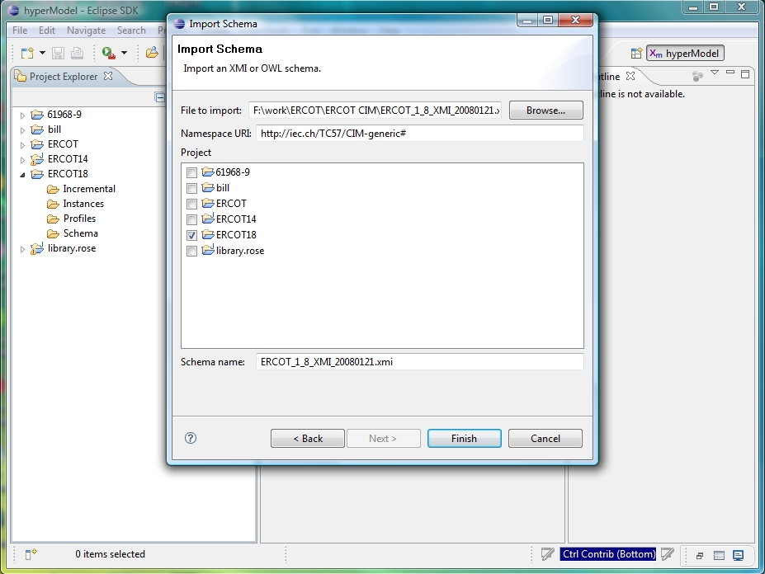
Initial Schema Import
Browse to find the XMI file to import
Check the project for the import
Don’t edit the Namespace
Click “Finish”

Slide 28
Creating and Editing a Profile
Creating and Editing a Profile

Slide 29
Creating a New Profile
There are four ways to create a new profile:
Create it from scratch within CIMTool
Import an OWL profile previously constructed using CIMTool
Import the profile from a data dictionary spreadsheet
Copy and paste an existing profile within CIMTool
Once created, profiles are stored in the ‘Profiles’ folder of the project
A project may have many profiles
Each profile will have a namespace
This following slides describe the creation of a new profile using the edit capabilities within CIMTool

Slide 30
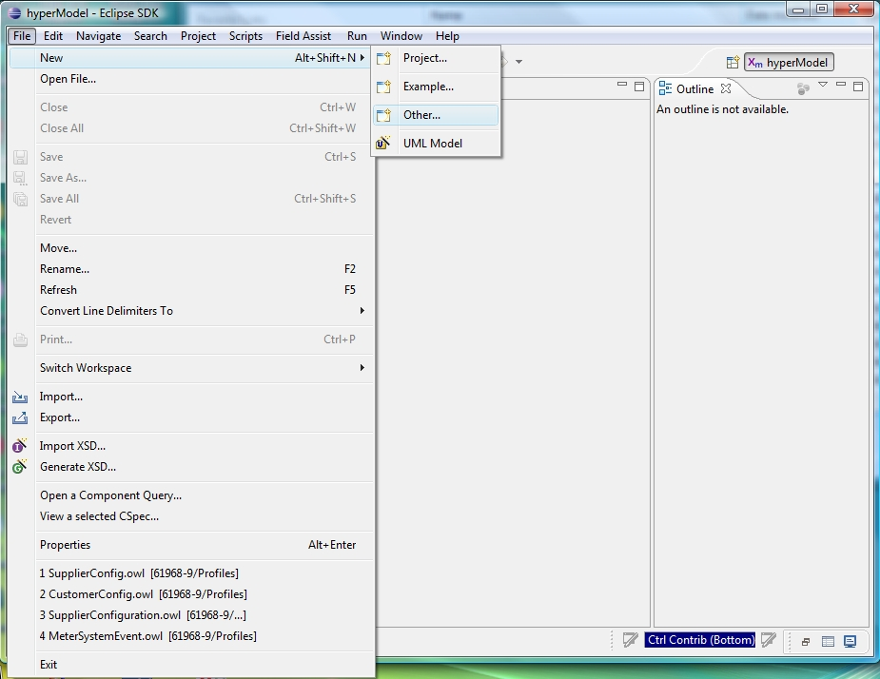
Creating a New Profile
Select ‘File > New > Other …’

Slide 31
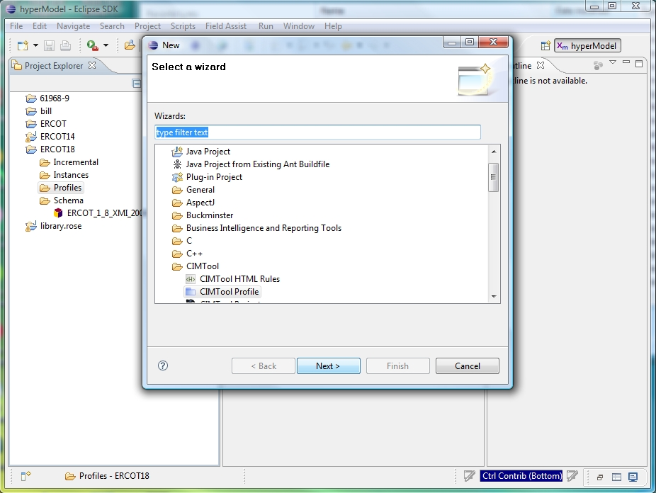
Creating a New Profile
Select ‘CIMTool Profile’ option
Click ‘Next’

Slide 32
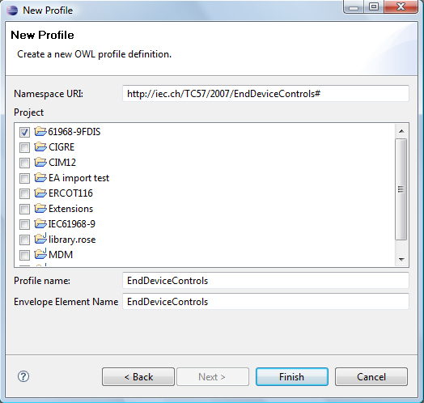
Creating a New Profile
Click on checkbox for the desired project
Determine a unique name for the profile that will not conflict with other profile names, then using the name:
Set the profile name
Set namespace URI
Set envelope element name
Click ‘Finish’

Slide 33
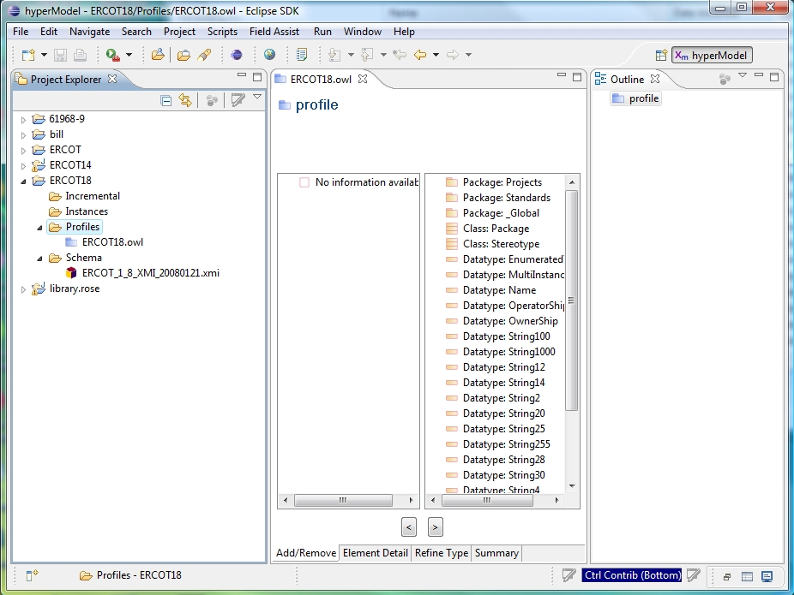
Browsing the Project
Click on arrows in Project Explorer to expand folders
Double click on the .owl profile file name in the to open it
Click on the profile name in the Outline window
In the Project Explorer frame you can always right click on a file name to see options

Slide 34
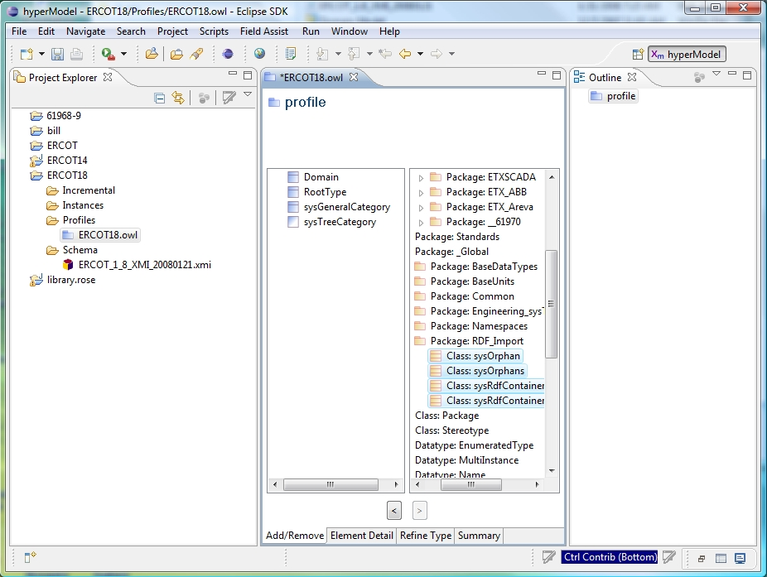
Adding Classes to Profile
Browse through model on the right side of Add/Remove tab
Select one or more classes on right side Add/remove tab
Classes are moved by clicking on <

Slide 35
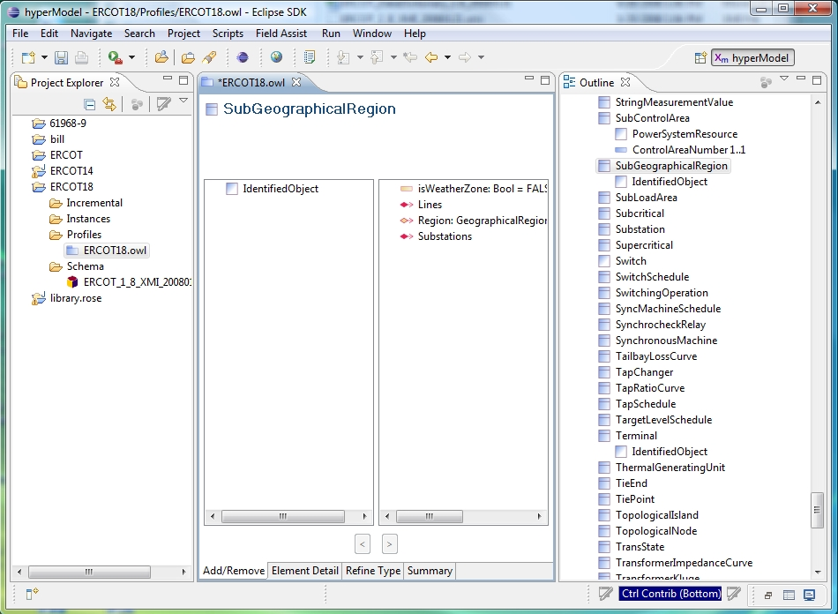
Adding a Property to Profile
Click on a class in the Outline
Properties are shown on the right side of the Profile Add/Remove tab
Click on property name on right side
Click on ‘<‘ to move property to left side

Slide 36
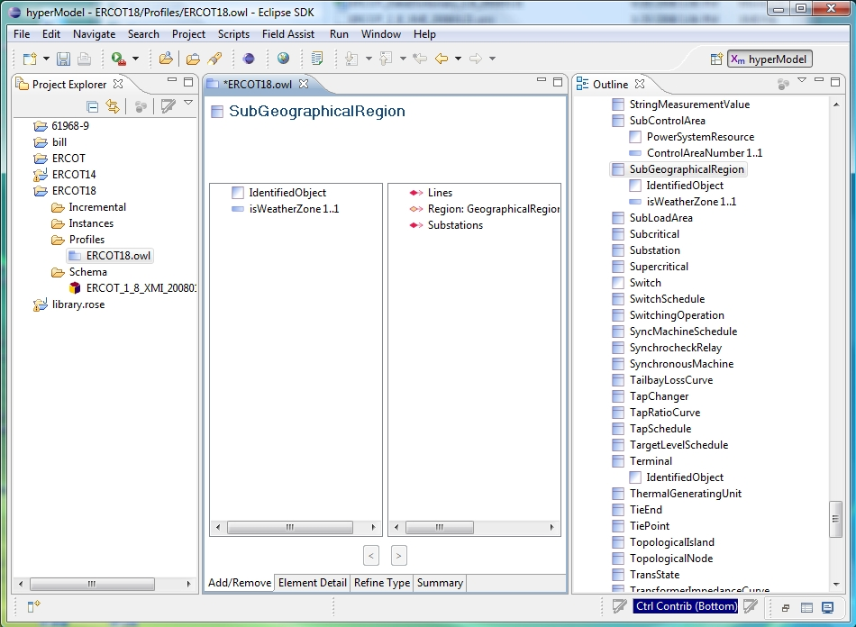
View After Adding a Property to profile
New profile property is seen on Outline view and the left side of the Add/Remove tab
You can remove properties by using the > button

Slide 37
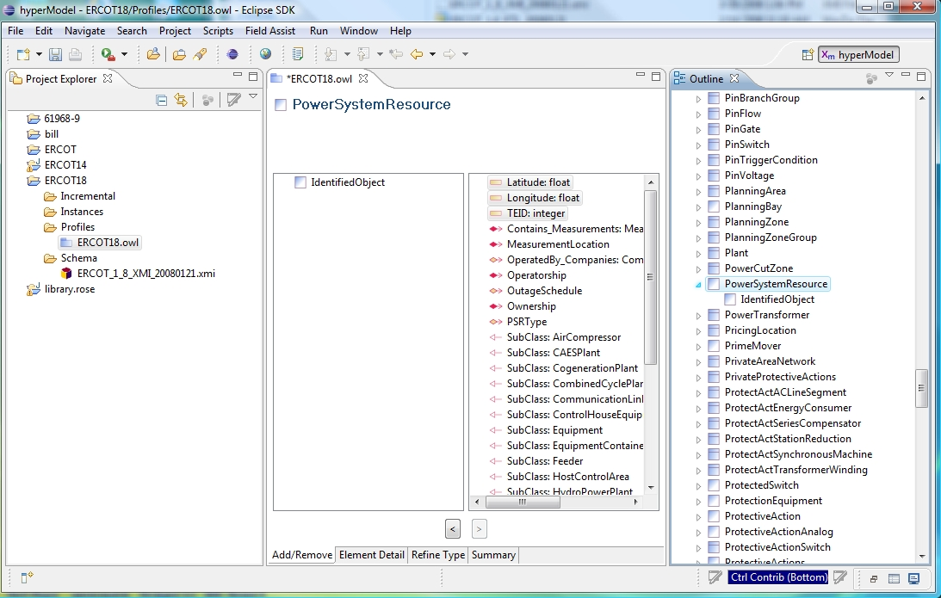
Adding Properties to Profile
Can move more than one property at a time

Slide 38
Importing a Profile
Importing A Profile

Slide 39
Importing a Profile
Sometimes it is desirable to use another profile definition as a starting point for a profile definition
CIMTool saves profile definitions in an OWL format
Profile definitions from another project or workspace can be imported to create new profiles

Slide 40
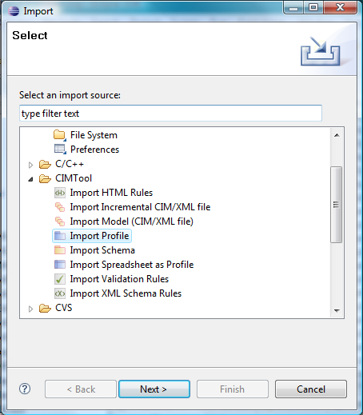
Importing Profiles into CIMTool
Select ‘File > Import’
Note the different import options under CIMTool
On ‘Import’ dialog select ‘CIMTool – Import Profile’ option
Check the project to import into
Browse to find the file to import
Click ‘Next’

Slide 41
Importing Profile from Data Dictionary
Importing a Profile from Data Dictionary

Slide 42
Importing Profiles
Some products can generate a Data Dictionary in the form of an Excel spreadsheet
The spreadsheet can define one or more profiles
Note that the spreadsheet can be maintained independently of any particular product
The Data Dictionary defines the classes, attributes and relationships that comprise one or more profiles
This can be imported into CIMTool to define a profile

Slide 43
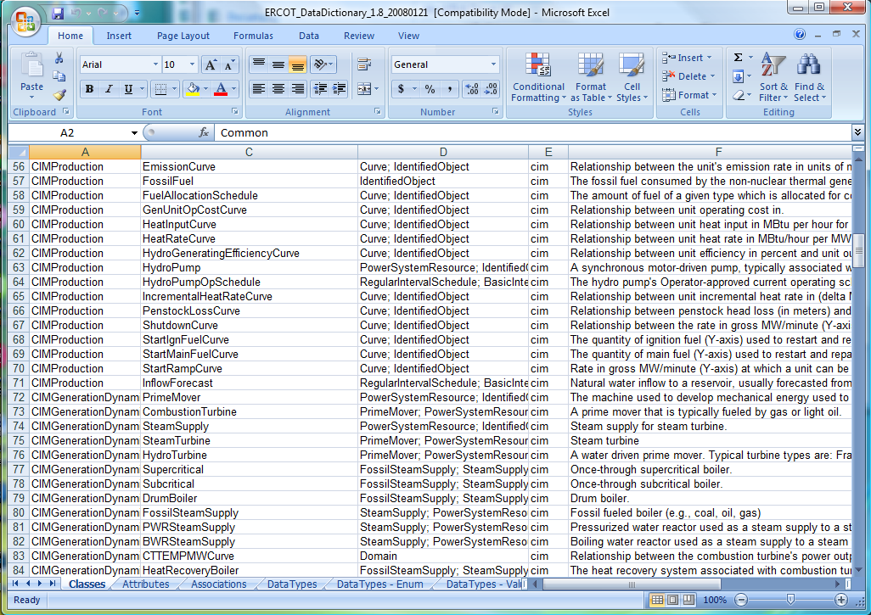
Data Dictionary
An Excel spreadsheet that describes the contents of one or more profiles
Tabs exist for Classes, Attributes, Associations, Data types, Enumerations and Units

Slide 44
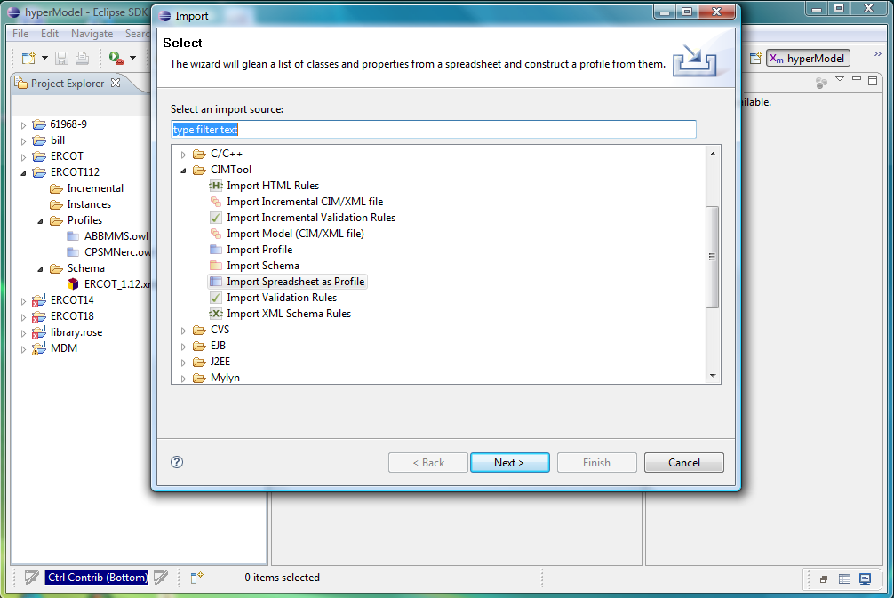
Importing Spreadsheet
Can import the Data Dictionary spreadsheet as a profile
File>Import
Select ‘Import Spreadsheet as Profile’ option

Slide 45
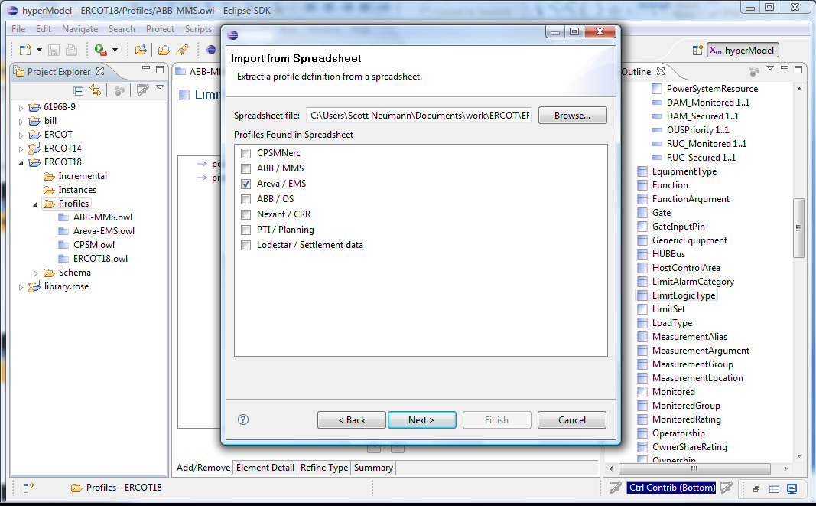
Importing Spreadsheet
The spreadsheet may identify one or more profiles
Can select which profiles to construct
Can only construct one at a time

Slide 46
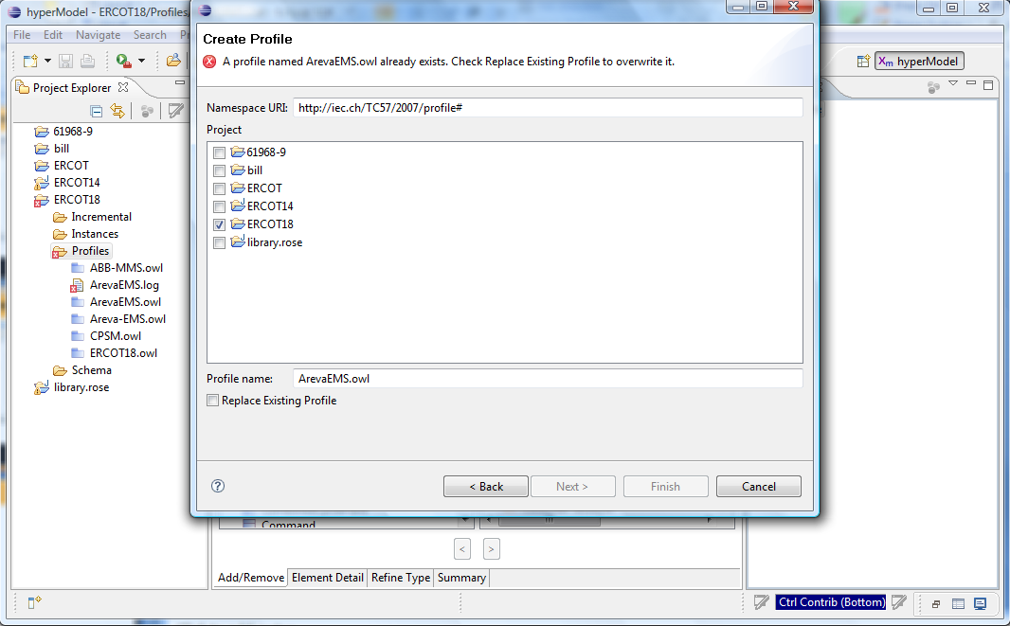
Importing Spreadsheet
Need to identify the project in which the profile will be created
The name of the profile is set by default, but can be modified

Slide 47
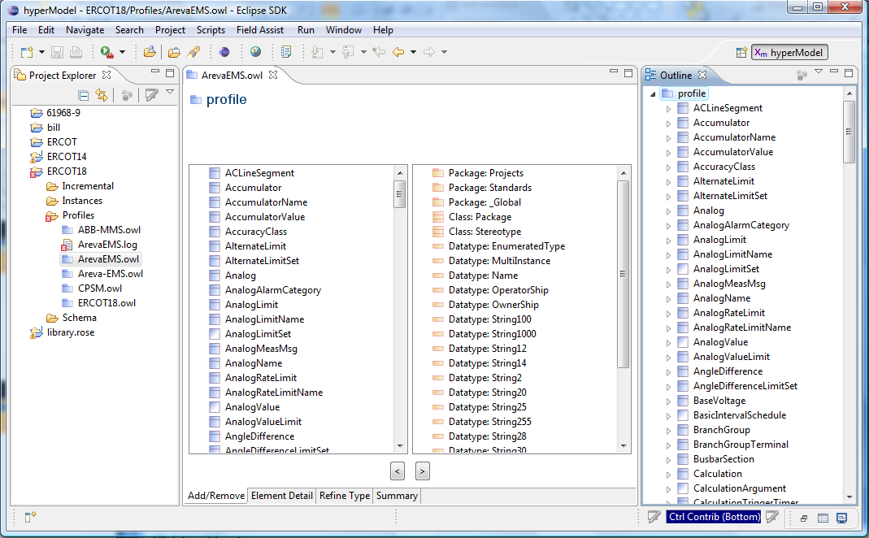
Importing Spreadsheet
New profile (.owl file) is created if there are no fatal errors
A log file is created that identifies any errors

Slide 48
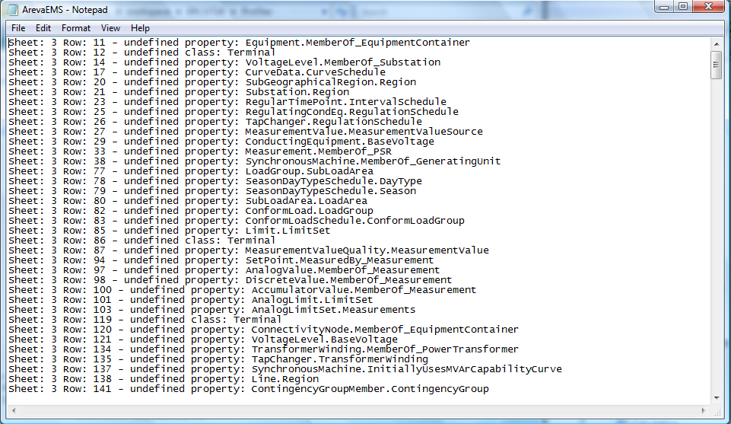
Importing Spreadsheet
A log file (.log) is generated with the profile to identify errors, if any
The log file identifies what could not be found for inclusion into the profile definition

Slide 49
Extending the Spreadsheet
You can also create a new profile definition in the spreadsheet for import into CIMTool using the following steps:
Insert new profile columns into the ‘Classes’, ‘Attributes’ and ‘Associations’ tabs
Provide the same profile name on row one of each of the added columns
Set the value of each new cell to ‘TRUE’ or ‘FALSE’
Run the spreadsheet import process as described previously
Look for errors in the log file

Slide 50
Creating a Profile using the Copy/Paste Function
Creating a Profile Using the Copy/Paste Function

Slide 51
Create a Profile Using Copy/Paste
51
Select the Profile you wish to copy
Right click on the .Owl file and select ‘Copy’
Right click again and select ‘Paste’
Enter the name of the new Profile to be created in the Dialog
The set of Profile files will be generated
Right click on the new .Owl file and select Properties
Enter the new Profile namespace in the dialog
This method will be demonstrated after the presentation
Notes:
51

Slide 52
Generating RDF Schemas
Generating RDF Schemas

Slide 53
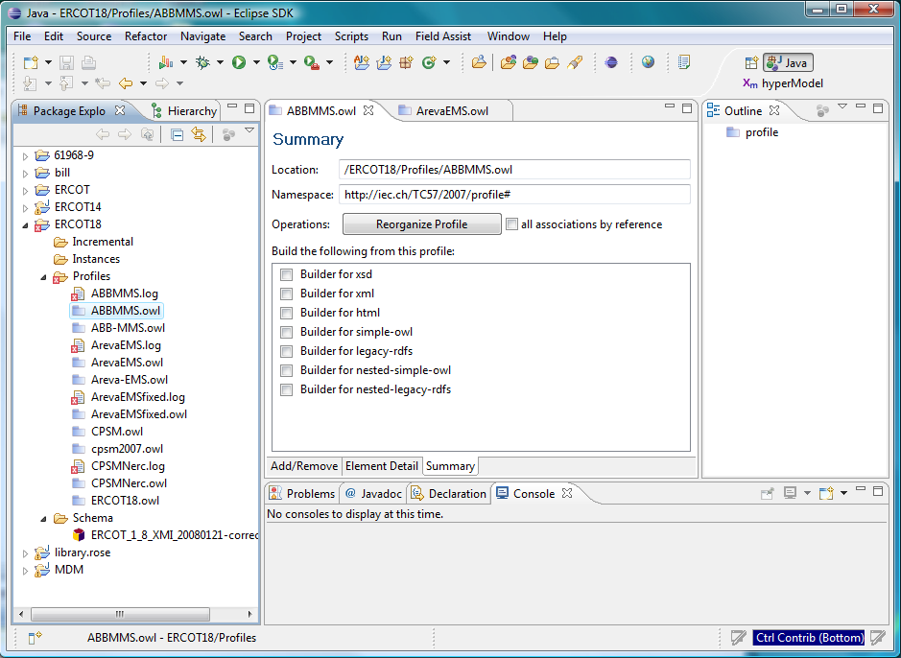
Generating RDF Schemas
Load the desired profile
Select the ‘Summary’ tab

Slide 54
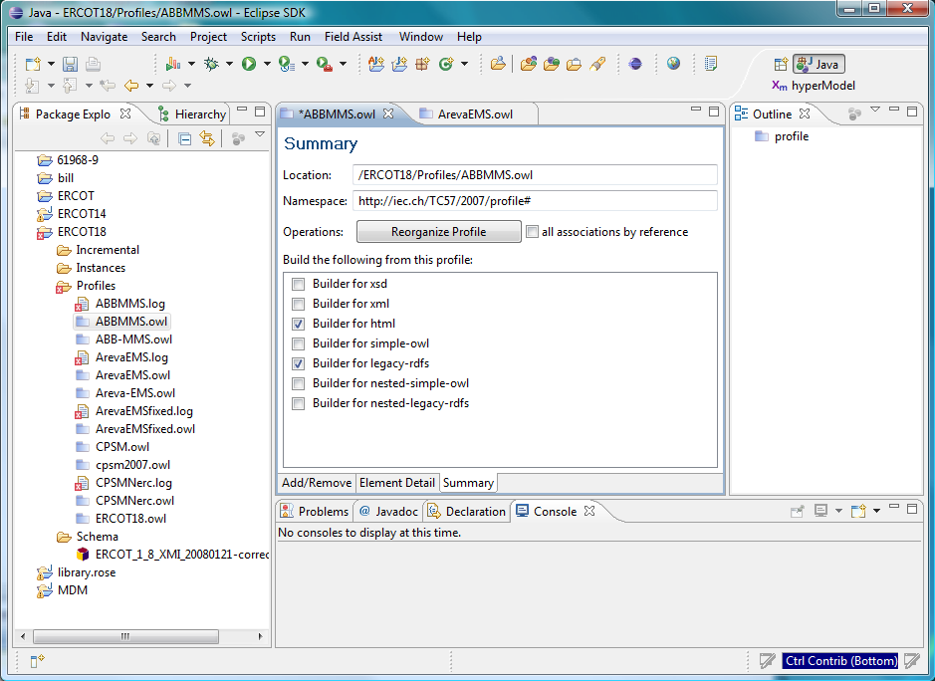
Generating RDF Schemas
Check ‘Builder for legacy-rdfs’
Check any other desired builder options
Click on ‘File>Save’

Slide 55
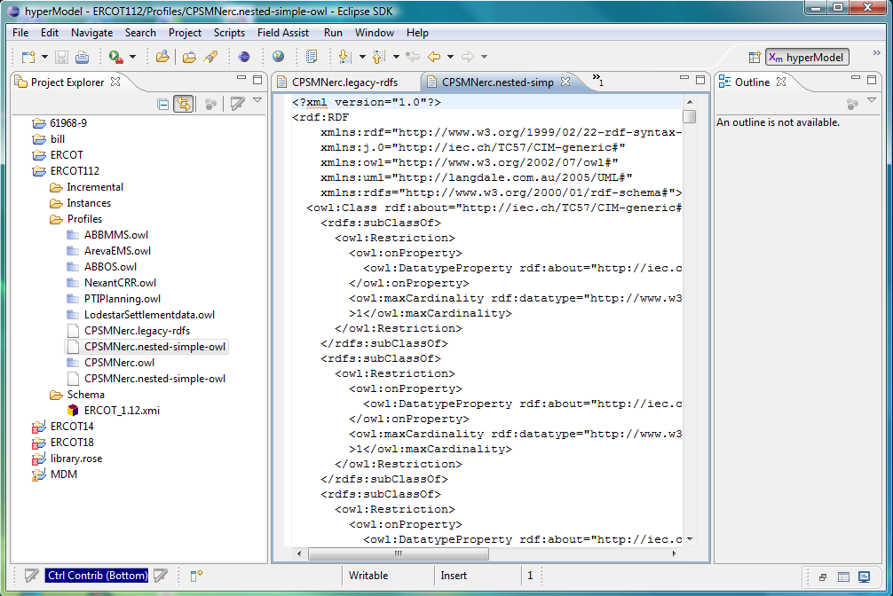
Generated RDF Schema
To view the actual RDFS, right click file name in Project Explorer
Then select ‘Open With > Text Editor’ option

Slide 56
CIMTool Output Options
CIMTool can generate several ‘styles’ of RDF or OWL as outputs for profile definitions, including:
Legacy RDFS (currently the most commonly used)
Legacy nested RDFS
Simple OWL
Simple nested OWL
Examples of each style will be displayed upon request
CIMTool can also generate XML Schemas and HTML as outputs
Both the form of XSDs and HTML generated can be controlled by stylesheets

Slide 57
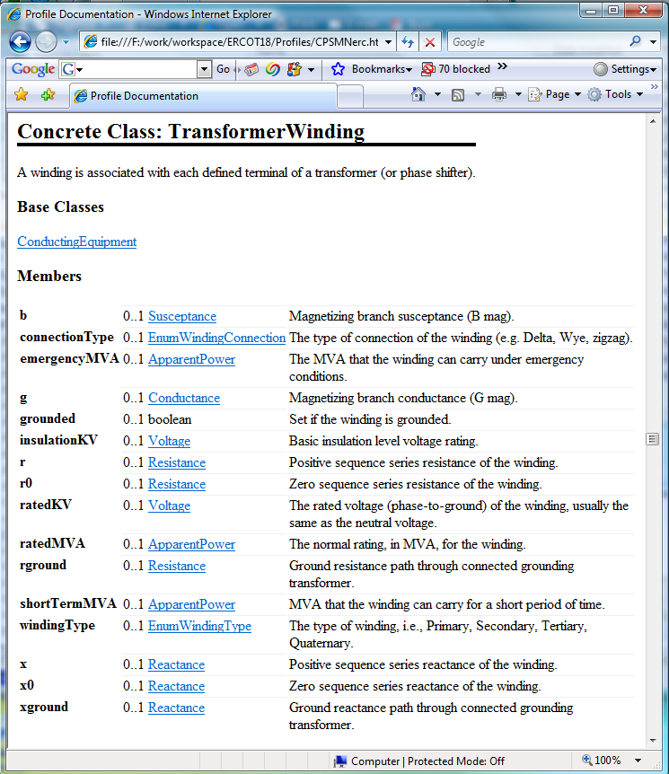
HTML Documentation
HTML option generates a single HTML file with description of all classes
Hyperlinks allow navigation between class descriptions and type definitions

Slide 58
Importing a Model
Importing a Model

Slide 59
Importing a Model
In order to validate a model, it must first be imported
Model files to be imported are in a CIM/XML RDF format with a .xml extension
Model files can be very large, as much as 2GB in size
The import process can take many minutes
The resulting model is placed in the ‘Instances’ folder of the project

Slide 60
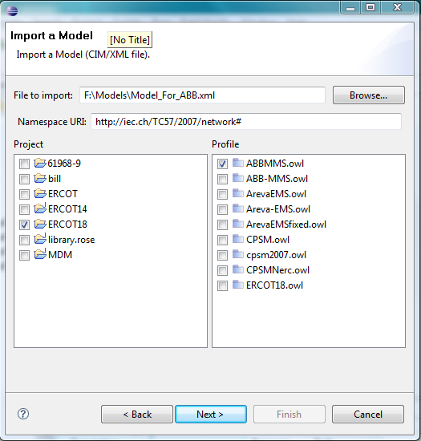
Importing a Model
Select ‘File > Import’
On ‘Import’ dialog select ‘Import Model (CIM/XML file)’ option
Click ‘Next’
Check the project to import into
Browse to find the file to import
Select an appropriate profile
Click ‘Next’
OR
Select the Model Import ICON on the toolbar and complete the screen shown

Slide 61
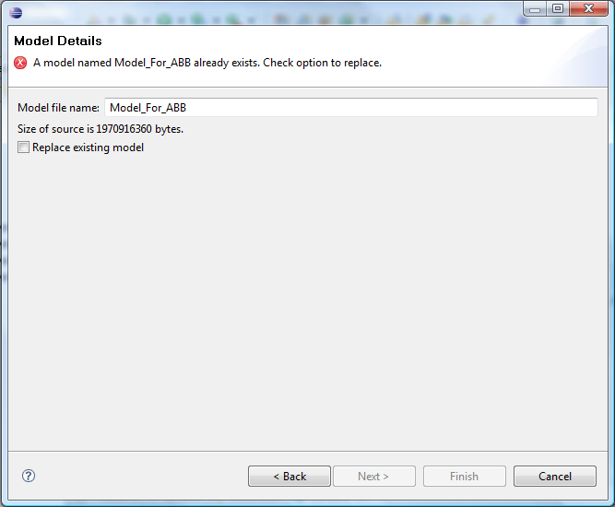
Importing a Model That Already Exists
Change the file name if you wish to save to a different sub folder
Check ‘Replace existing model’ if you wish to overwrite
Click ‘Finish’
Wait for the import to complete, as it may take several minutes (up to an hour for a very large model)
Watch the progress icon at the bottom of CIMTool where it says ‘Importing model …’

Slide 62
Imported Model
The imported RDF model is stored within the Instances folder of the project
Errors are recorded in log files
A folder is created to store the model in typically many smaller files that have a .ttl extension
The .ttl files are in Terse RDF Triple Language format (more compact than CIM XML)

Slide 63
Validating a Model
Validating A Model

Slide 64
Validating a Model
Validation of the model occurs when a model is imported
Errors are identified in log files in the ‘Instances’ folder of the project with a name in the form <profile>.log
If errors exist, a diagnostic file is created which can be browsed
CIMTool has a default set of validation rules, where the rule file is named <profile>.split-rules
Rules can be edited and extended

Slide 65
Example Validation Errors
Undefined classes
Undefined properties
Instantiation of abstract classes
Illegal cardinality on an association (e.g. more or less associations than expected)
Range violation for a data item
Illegal domain of a property
Base voltages for conducting equipment connected at a connectivity node do not agree
Isolated nodes
Untyped objects
Missing or extra terminal
Duplicate properties
Unexpected loop

Slide 66
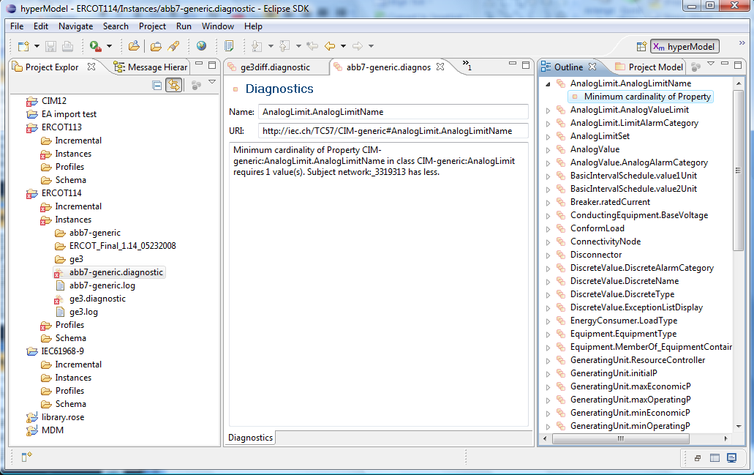
Browsing Diagnostic File

Slide 67
Importing and Validating an Incremental Model
Importing and Validating an Incremental model

Slide 68
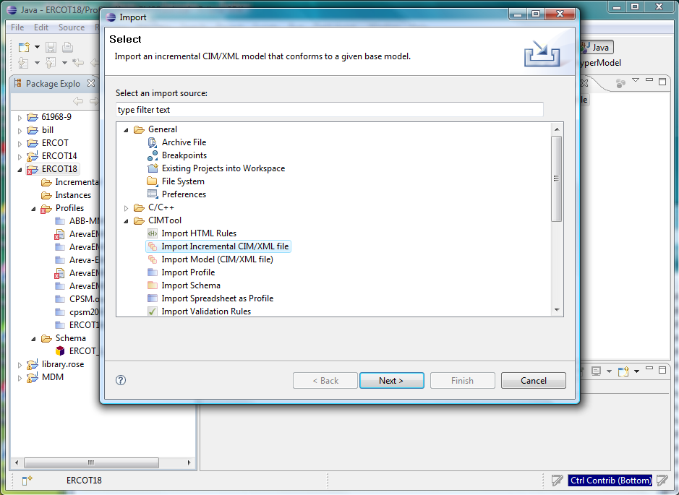
Importing Incremental CIM/XML
First step is to import an incremental CIM/XML file using File > Import and select CIMTool/Import Incremental CIM/XML file (or use the ToolBar ICON)

Slide 69
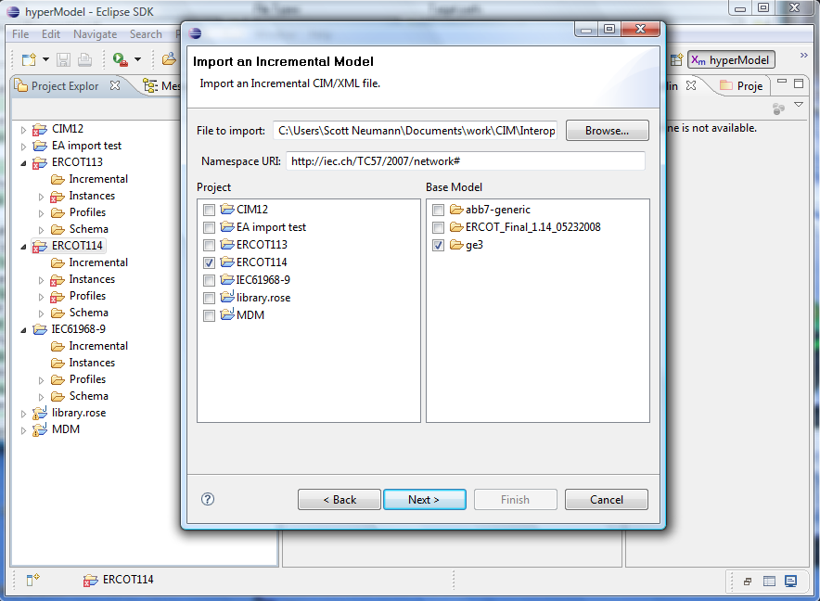
Importing Incremental CIM/XML
Must have imported a base instance model BEFORE attempting this
Need to browse to select file
Need to select the appropriate base model
Errors will be reported in a log file

Slide 70
Validating an Incremental Model
Validation occurs when the model is imported
Errors are identified in log files in the ‘Incremental’ folder of the project with a name in the form <profile>.log
If errors exist, a diagnostic file is created which can be browsed

Slide 71
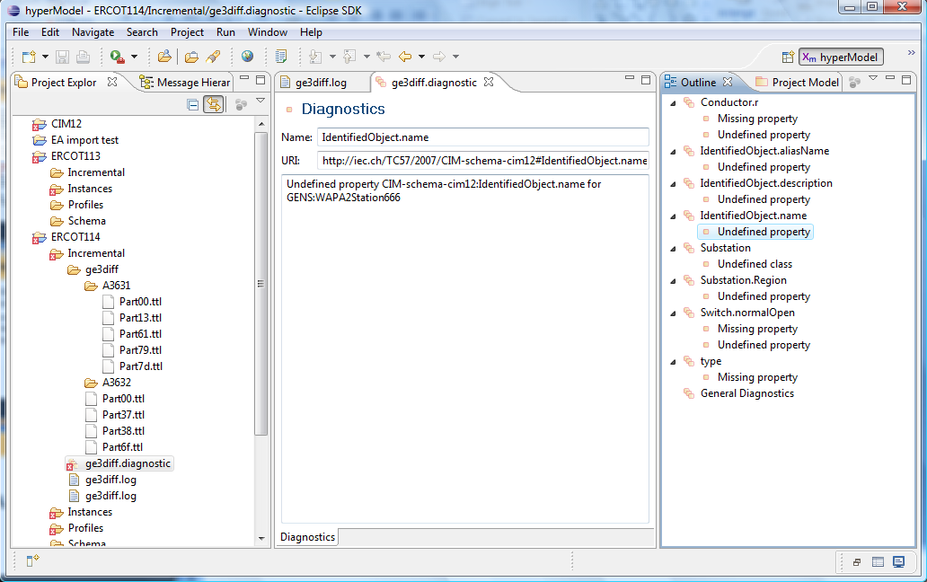
Browsing Diagnostic File

Slide 72
Updating a Schema
Updating A Schema

Slide 73
Updating a Schema in CIMTool
From time to time, there may be updates to the UML model. These updates will result in a revised XMI file
You should not directly replace a file in the CIMTool workspace directory
You should instead, using CIMTool File menu options:
Delete the old schema
Import the new schema
Be sure that the correct namespace is entered
Profiles with errors will be flagged with a red X

Slide 74
Namespaces
A commonly used namespace is http://iec.ch/TC57/CIM-generic#
If namespaces do not match between schema, profiles and the model files errors may be encountered
Default namespaces to be used by CIMTool can be changed using Window > Preferences and selecting CIMTool option
Most problems encountered in CIMTool surround the namespace.
It is best to use the default (defined above) for all project files

Slide 75
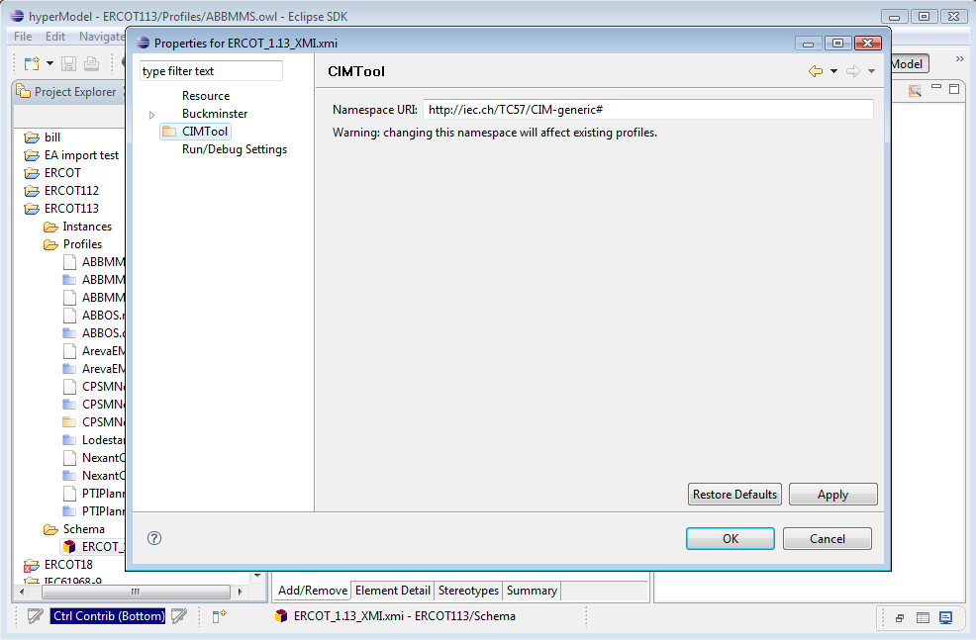
Changing Namespaces
Namespaces can be changed by right clicking on a file name in the Project Explorer and then selecting ‘properties’
The namespace is shown on the CIMTool property dialog
Namespaces can be changed as desired
Note that this may impact existing profile definitions

Slide 76
Miscellaneous
Miscellanous

Slide 77
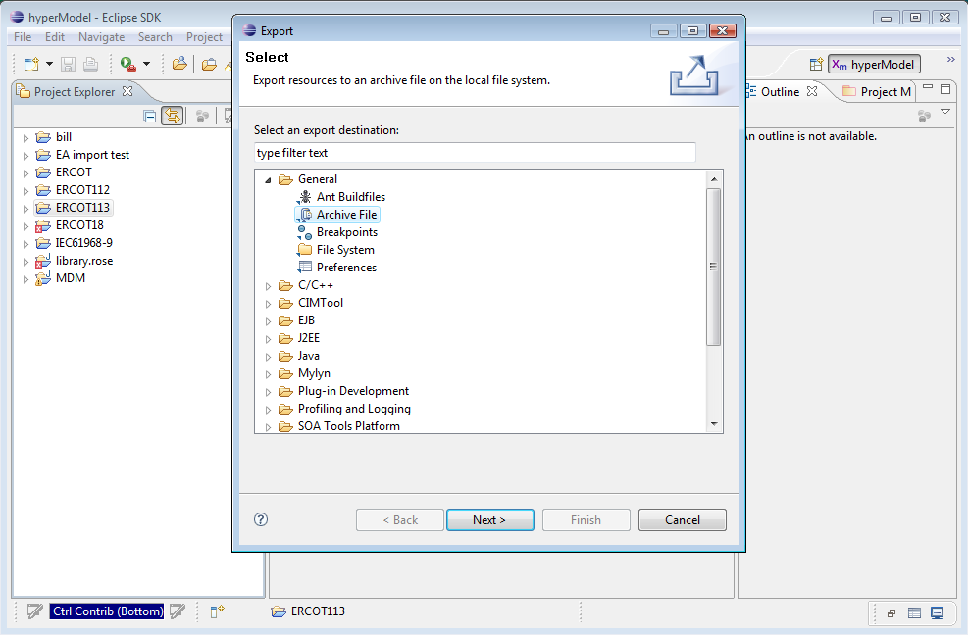
Exporting a Project
It is often necessary to export a project for use by others, or to use on other computers
Use File > Export
Select Archive File option
Select Next

Slide 78
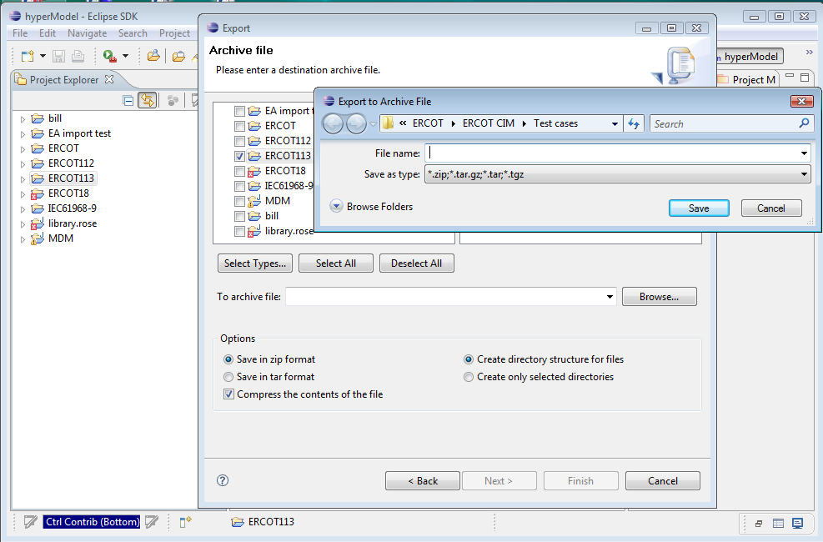
Exporting a Project
Need to select output format, ZIP is usually best
Need to select output file name
Project can be later imported back into Eclipse using File > Import

Slide 79
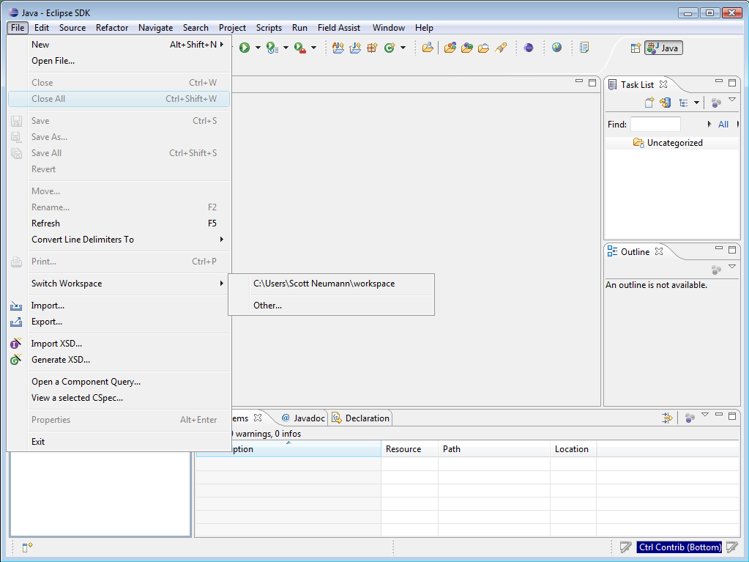
Switching Workspaces
Sometimes it is necessary to move or change the location of your workspace folder, or use multiple workspaces
To point Eclipse to the new workspace folder use File > Switch Workspace
Select the desired workspace folder
The settings will be updated and Eclipse will restart

Slide 80
Renaming Resources
Sometimes it is necessary to rename projects, folders within a project or files within a folder
It is important to do this using Eclipse, instead of directly making changes to the resource outside of Eclipse
To rename, right click on the desired resource in the Project Explorer and select ‘Rename’
Now you can change the name of the resource

Slide 81
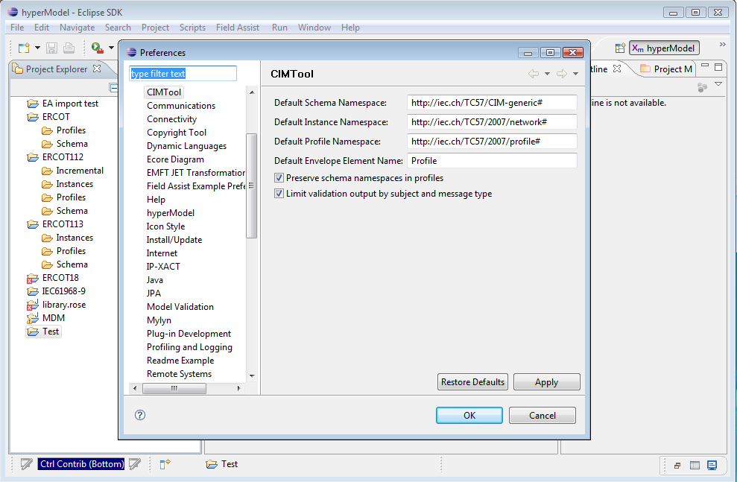
Changing CIMTool Preferences
Preferences can be changed using Window > Preferences and selecting CIMTool option
Select ‘Apply’ and ‘OK’ after editing to save

Slide 82
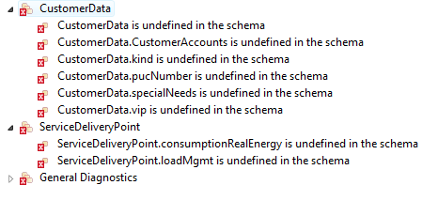
Diagnostics
Errors will be written to ‘.diagnostic’ files
These are often the consequence of changes in the CIM that have eliminated used classes, relationships or attributes
Profiles can then be edited to correct the problems

Slide 83
Backing Up a Project
Easy way …
Easiest way to back up a project directory is to use WinZip or a similar archive tool
Using WinZip (or similar tool), simply create an archive file of the project folder within the workspace
Using a source repository …
Many commercial source repositories options exist that integrate with Eclipse
Plugins can be found for:
CVS
Visual Source Safe
Clear Case

Slide 84
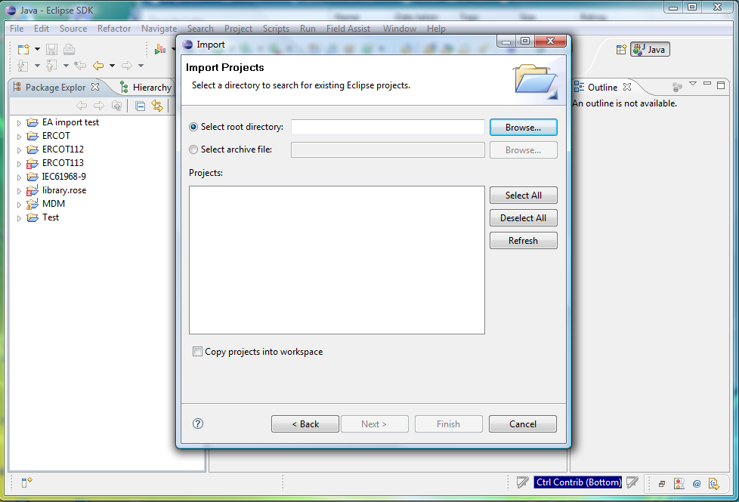
Importing a Project
Select File > Import > To import projects into Workspace
Click Next
Browse to identify a project directory
Can use ‘Copy projects into workspace’ to make a copy of the directory instead of working directly out of the chosen directory

Slide 85
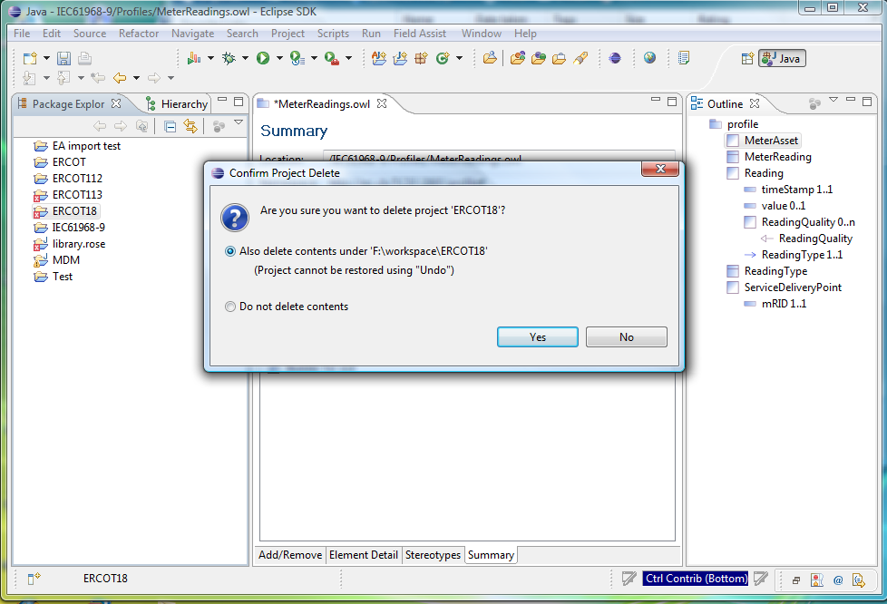
Deleting a Project
Right click on name of project in the Project Explorer
Files will only be deleted if the ‘Also delete contents under …’ option is selected
Click ‘Yes’

Slide 86
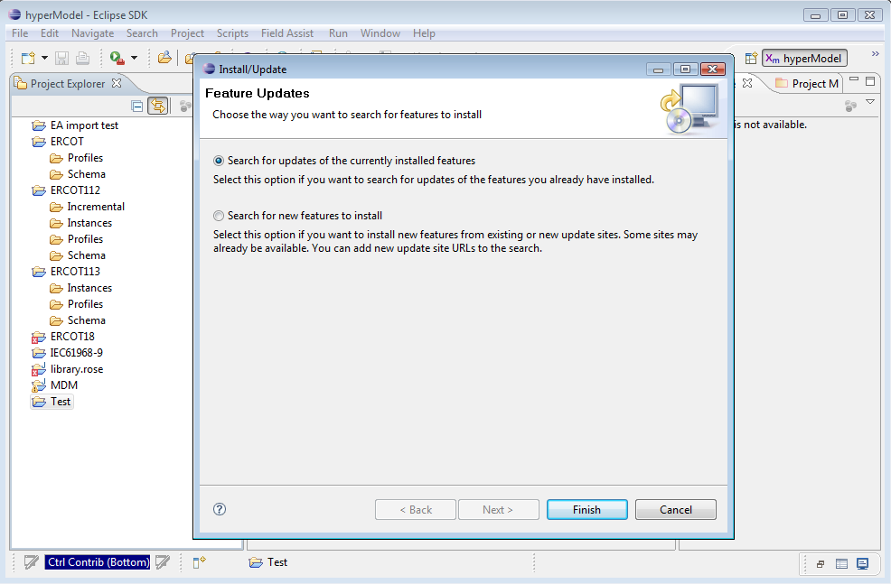
CIMTool Updates
TO obtain updates to Eclipse and CIMTool
Use Help > Software Updates > CIMTool
Select ‘Search for New Features to Install’ option

Slide 87
Where Do I Get …
CIMTool and Eclipse:
http://eclipse.org
http://cimtool.org
CIM:
http://www.ucaiug.org/CIMug
IEC Standards:
http://www.iec.ch

Slide 88
Acknowledgements
Not possible without the efforts of Arnold DeVos, the developer of CIMTool
Thanks to those companies that also helped to fund CIMTool development
Thanks to the CIM model managers that have helped to advance the CIM:
Kurt Hunter, Siemens (WG13)
Kendall Demaree, Areva (WG13)
Lars-Ola Osterlund, ABB (WG13)
Tatjana Kostic, ABB (WG14)
Margaret Goodrich, SISCO (WG16)

Slide 89

More Information
Eclipse web site: http://eclipse.org
CIMTool web site: http://cimtool.org
E-mail: margaret@sisconet.com
Screen Shots Compliments of UISOL and Scott Neumann

